Slide 1
Documentum Webtop User Processes
Initial Setup and Operation

Slide 2
What is Documentum?
The Documentum system is an electronic document filing cabinet
The user app to access documents is called Webtop
Users log into the Webtop app using their UTHealth network userid and password
The UTHealth network address is https://webtopprod.uthouston.edu/webtop/

Slide 3
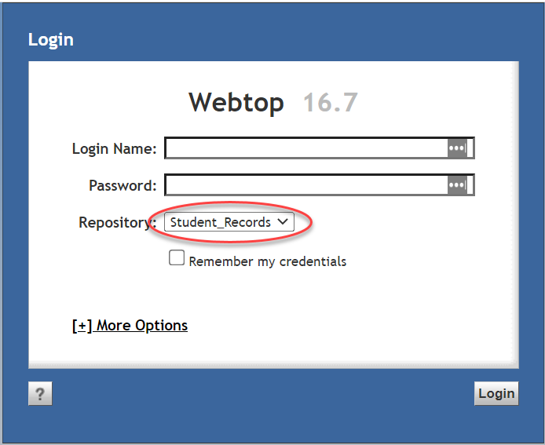
Initial Webtop Setup Steps
Chrome web browser works best
Start the app (see last slide for the address)
Key in your userid and password, then CHANGE the Repository to be “Student_Records”
Click on Login

Slide 4
Initial Webtop Setup Steps
Configure to use Saved Searches
DO NOT USE the Search box in the top left corner of the Webtop session page
Click on the Tools menu, then select Preferences
In the Preferences: General popup, change the “Section to start in” to be Saved Searches. Click OK.
Logout (button top right) then log back in

Slide 5
Initial Webtop Setup Steps
Set up Saved Searches
This login should have selected Saved Searches in the left pane. If not, go back to the previous slide.
Below the Webtop menus, select Saved Searches so that it is bold and not underlined
At the right edge of the display, change Items per page to be 100
Basic Setup is now complete.

Slide 6
Why use Saved Searches?
Search box (top left) results are unpredictable because default parameters the user cannot see are used.
All documents for a person may not be retrieved.
Documents for more than 1 person may be retrieved.
DO NOT USE the Search box.
Saved Searches…
are pre-configured to retrieve all documents for 1 person
display the retrieval list with ADDITIONAL INFORMATION about the document(s) in the columns presented

Slide 7
Using Saved Searches
Saved Searches may be
Public (generally available to all users) or
Private (restricted to the creator)
The Owner column of the Searches list denotes who created each one.
Owner = docuadmin are generic searches, created by an administrator userid
Owner = Another User may be available to you, but also may be modified by the creator for some special purpose.

Slide 8
Using Saved Searches
Click on the column heading word Name. This will sort this list into alphabetic order (makes it easier to find what you are looking for)
Search for Documents, not Folders
Scroll down the list of Searches to find a blue icon’ed search owned by docuadmin
Document Search (uses the Studentid)
Documents – Student Name (uses last and first name)
Right-click and choose Edit (to edit the searching criteria)

Slide 9
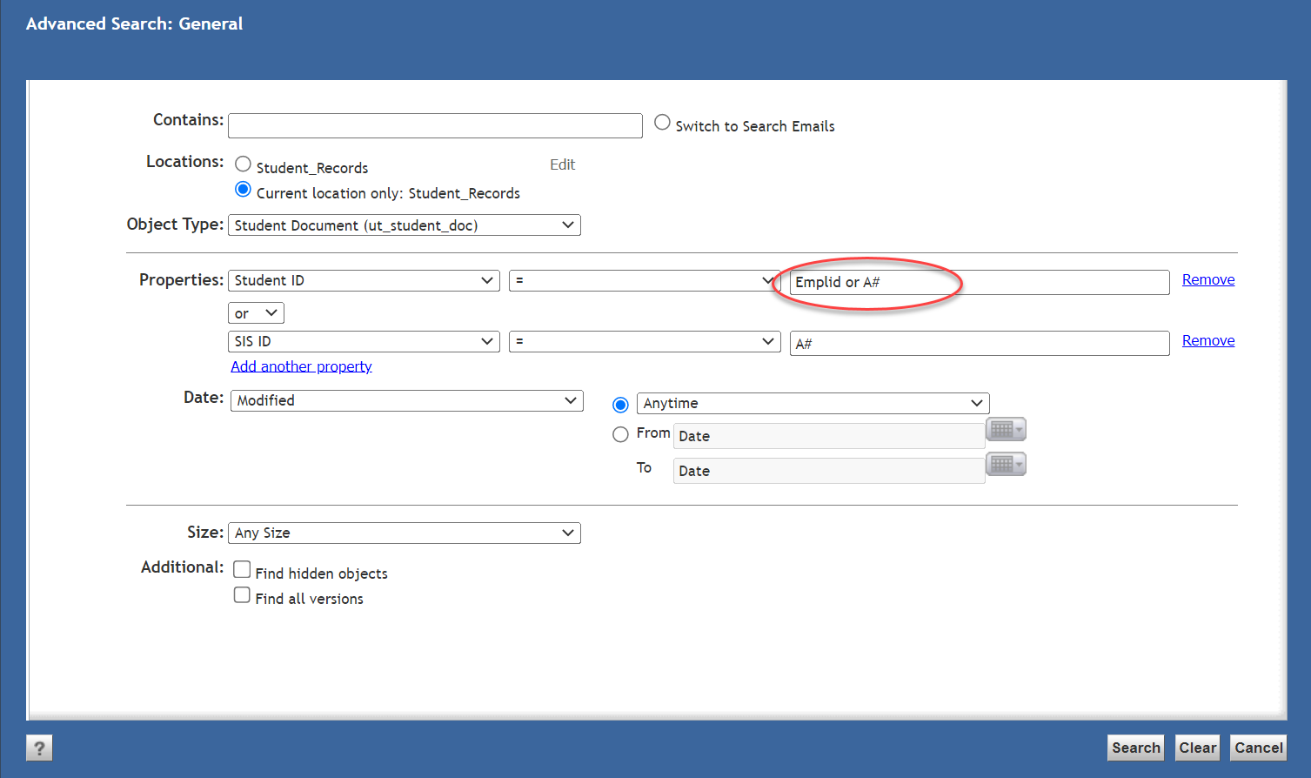
Using Saved Searches
Document Search
This search will find every document for an individual person
Replace the text “Emplid or A#” with the Studentid (CS Emplid) for the person
Click Search

Slide 10
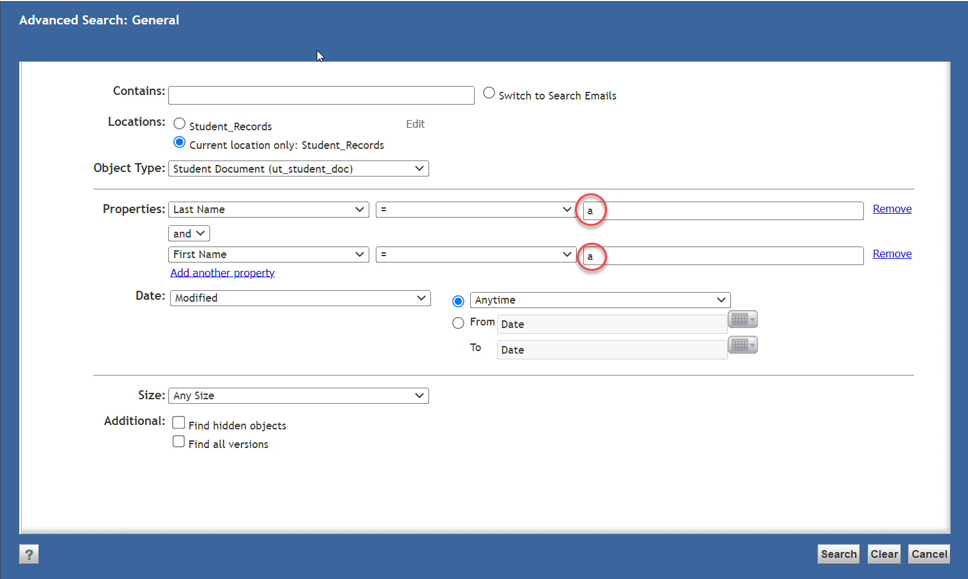
Using Saved Searches
Documents – Student Name
This search will find every document for that student’s name
Replace the text “a” with the Last and the First name
Click Search
Note: Names change. Follow this search with a Document Search for the studentid

Slide 11
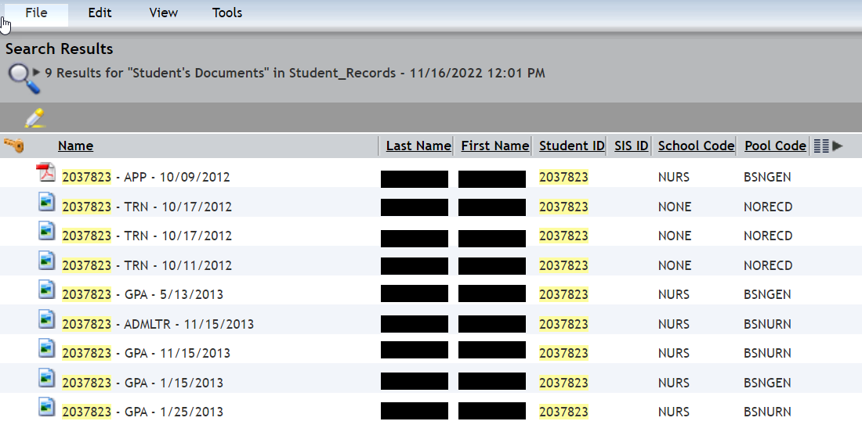
Using Saved Searches
Documents found
Searching for 2037823 returns 9 documents.
Doctype is embedded in the document Name
School Code is presented
Pool Code contains the CS Plan Code

Slide 12
Using Saved Searches
Viewing and Navigating
Documentum security restricts opening documents for another School, unless there is a dual degree agreement between the two schools
Ex: NURS users cannot open documents for GSBS
Ex: SBMI and SPH users may open documents for both
Ex: MDAH users cannot open documents for UTHealth schools
Documents for School = None are available to all users

Slide 13
Using Saved Searches
Viewing and Navigating
To view a document, double-click the Name. A TECHNICAL point……Documentum itself does not DISPLAY the document, it retrieves the document and gives it to Windows for display. Windows must have an App identified as a default viewer for that document type (see the next slide for more info)
To navigate to another student, use the Edit action to return to the Search criteria page, then enter a new student

Slide 14
Windows Default Apps
Search Windows using for “default apps”
Scroll to the bottom and select “Choose default apps by file type”
Once the list displays (takes a short while), find and verify the following
.pdf has a default app of Adobe Reader (preferred, and free), Adobe Acrobat, or some other pdf reader program
.tif and .tiff has a default app of an image viewer which can display multi-page tif/tiff image files.

